Slide 1
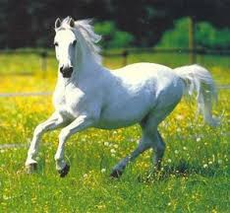
Summer of the Beautiful White Horse
By William Saroyan

Slide 2
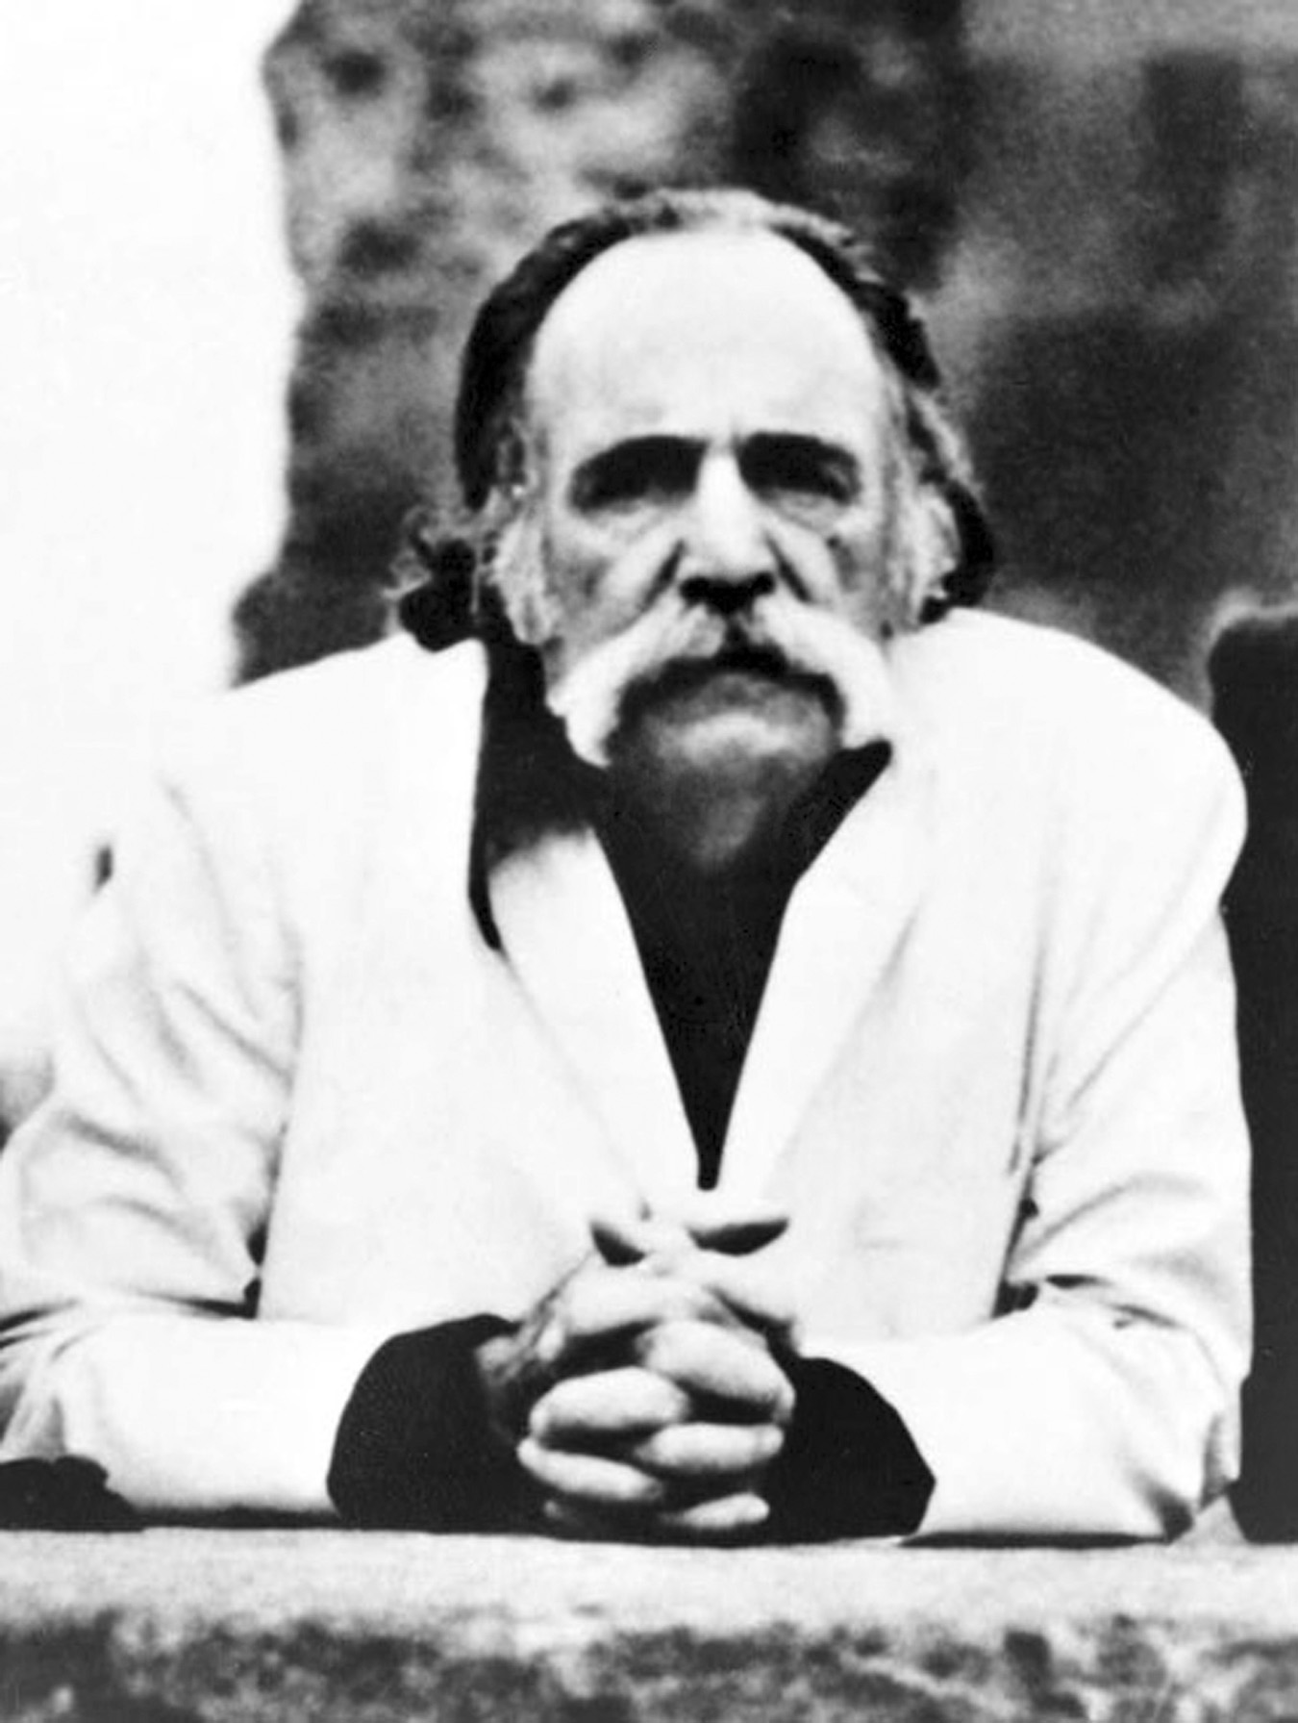
Author
William Saroyan was an Armenian-American novelist, playwright and a story writer. He was awarded thr Pulitzer Prize for drama in 1940, in 1943 Academy Award for best story for the film adaptation of his novel ‘The Human Comedy’.
Born: 31 Aug 1908, Fresno, California, United States
Died: 18 May 1981, Fresno, California, United States

Slide 3
Introduction
"The Summer of the Beautiful White Horse" is a short story by William Saroyan, published within the collection ’My Name is Aram’. It tells the story of two boys, Aram and Mourad, who belong to a very poor Garoghlanian family (Armenian tribe).
The two boys live in the San Joaquin Valley in California.

Slide 4
Vocabulary
Pious - having or showing or expressing reverence for a deity
Capricious - inconsistent change of mood
Vagrant - a wanderer with no established residence or means of support
Stillness - (poetic) tranquil silence
Vineyard – plantation of grapevines used in winemaking
Orchards – a piece of land of the plantation of fruits
Irrigation ditches – manmade channel used to deliver water to homes, industries and other uses
Trot – proceed with something
Descendant – a system that develops from an earlier simple version

Slide 5
Streak – race
Vazire – a name
Fury – anger
Reared – raised
Snorted – breathed out
Alfalfa – a flowering plant
Parlour – a sitting space in a house
Surrey – a country in South-East England

Slide 6
Explanation
Aram and Mourad were cousins. Aram was nine years old. Mourad was thirteen. Both of them were fond of horse-riding. They belonged to the garoghlanian tribe of Armenians.
The narrator heard a tap on the window of his room. When he looked out, he saw his cousin Mourad sitting on a beautiful white horse. He could not believe his eyes because Mourad belonged to a poor family. He could not afford to buy such a lovely horse. Surely, he had stolen it.
Garoghlanian family had the reputation for honesty that has been maintained by its family members for hundreds of years. Every one trusted them. These people took pride in the fact that they were honest in spite of their poverty.
Aram could not think that his cousin – a member of the honest tribe – could ever steal.
Aram justifies the theft to himself, reasoning that perhaps it isn’t actually stealing unless they try to sell the horse.

Slide 7
Unable to resist any longer, Aram hops on the horse behind Mourad. As they begin their ride, Aram reflects on his cousin’s unconventional nature: everyone says he inherited “the crazy streak” of the tribe from their uncle Khosrove. Though Mourad is not a direct descendent of Khosrove, the tribe believes that Khosrove is the “father of his spirit.”
The two enjoy a long and satisfying ride until Mourad orders Aram off the horse, wanting to ride alone. Aram demands the same privilege, so after Mourad finishes his solo ride, Aram climbs back on. Unfortunately for Aram, the horse runs into a neighbor’s vineyard, where it begins to leap over vines. Aram is soon tossed from the horse.

Slide 8
Mourad comes running, and both boys frantically look for the horse. They eventually find it and hide it in the barn at an abandoned vineyard. At this point, Aram realizes that Mourad has been hiding and riding the horse for some time and only told him about it that morning. When Aram questions him about this, Mourad again refuses to give details, claiming he doesn’t want Aram to have to lie if they are caught. The boys return home.
Later in the day, a farmer by the name of John Byro visits Aram’s house. Byro mentions that his horse was stolen a month ago and is still missing. Upon hearing this, Aram confronts Mourad. He wants Mourad to promise that the horse won’t be returned until he can learn how to ride; to this, Mourad complains that it will take a year for Aram to master riding a horse. The boys settle on returning the horse in six months and ride it every morning.

Slide 9
One day two weeks later, the boys are riding the horse back to the deserted vineyard and run into John Byro. Byro observes that the horse resembles the one he lost—even its teeth are the same. If not for the honest reputation of their family, Byro says, he would think the boys had stolen his horse. He remarks that “a suspicious man would believe his eyes instead of his heart” and goes on his way.
Byro’s faith in their family makes them feel sorry for their action. The two boys say goodbye to the horse and return it to Byro’s barn early the next morning. That afternoon, Byro brings the horse to Aram’s house, claiming that it is “stronger than ever” and “better-tempered” than before.

Slide 10
Thank You..

